Slide 1


Information Extraction from Social Media: Tasks, Data, and Open-Source Tools
Shubhanshu Mishra^{1*}, NLP Researcher
Rezvaneh (Shadi) Rezapour², PhD Candidate
Jana Diesner², Associate Professor
¹ Twitter, Inc.
² University of Illinois at Urbana-Champaign (UIUC)
*Work presented here was done during my PhD at UIUC
Content and views expressed in this tutorial are solely the responsibility of the presenters.
https://socialmediaie.github.io/tutorials/WWW2021/

Slide 2
Initial setup
Open google Colab notebook specified at: https://socialmediaie.github.io/tutorials/WWW2021/#software-setup
On Colab click Connect
Then on the Menu click Runtime > Restart and run all
Meanwhile you can also follow the steps on the link above to install SocialMediaIE locally on your machine.
If you face any issues with installation please report an issue at: https://github.com/socialmediaie/SocialMediaIE/issues

Slide 3
Agenda
Introduction (30 mins) (Shubhanshu)
Applications of Information Extraction(IE) (30 mins) (Shubhanshu and Shadi)
Collecting and distributing social media data (20 mins)
Break (10 mins)
Hands on Practice (Shubhanshu)
Improving IE on social media data using machine learning (1 hr)
Conclusion and future direction (20 mins)

Slide 4
Introduction

Slide 5
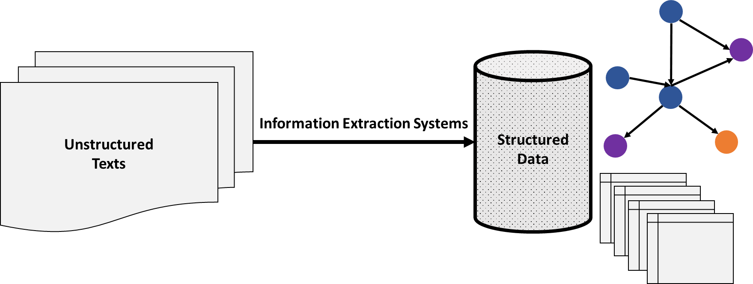
Information extraction https://shubhanshu.com/phd_thesis/
“Information Extraction refers to the automatic extraction of structured information such as entities, relationships between entities, and attributes describing entities from unstructured sources.”
– (Sarawagi, 2008)

Slide 6
Digital Social Trace Data https://shubhanshu.com/phd_thesis/
Digital Social Trace Data (DSTD) are digital activity traces generated by individuals as part of a social interactions, such as interactions on social media websites like Twitter, Facebook; or in scientific publications.
Inspired from Digital Trace Data (Howison et. al, 2011)

Slide 7
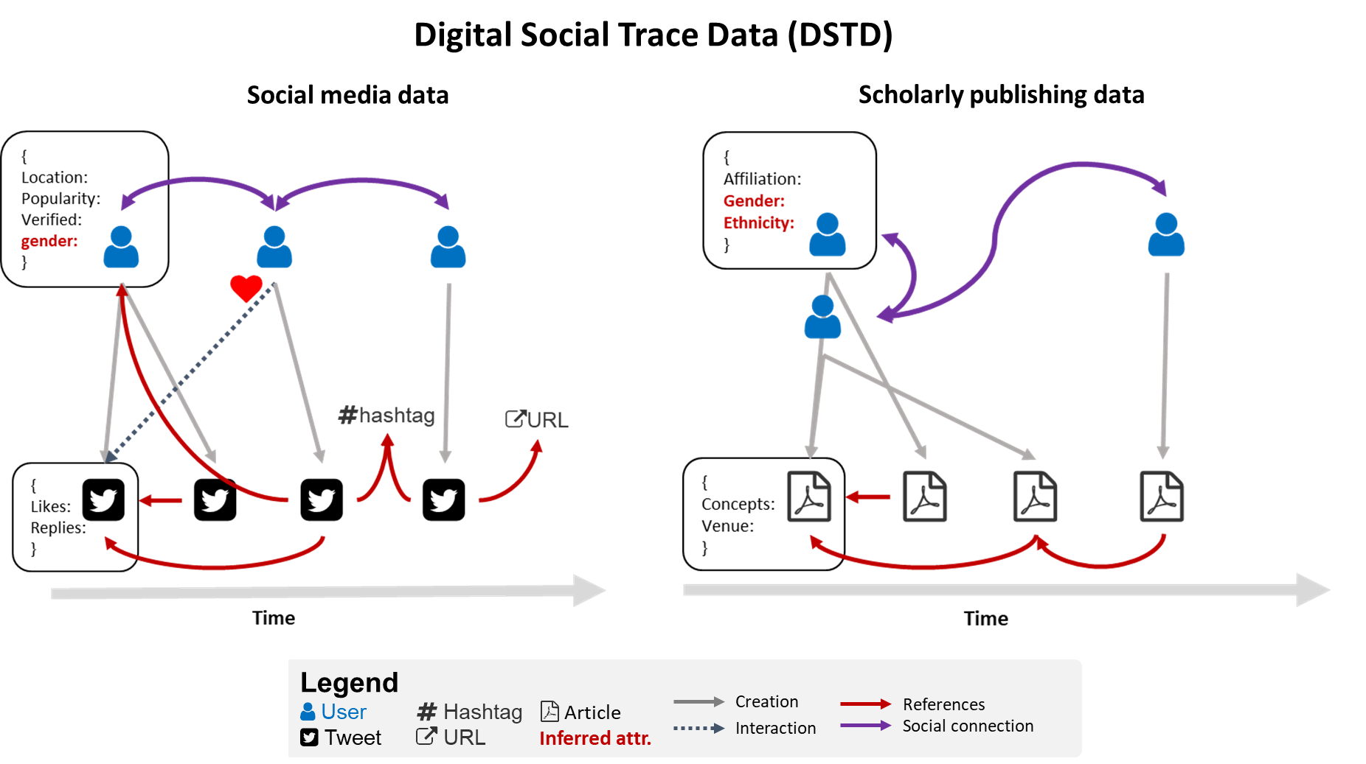
https://shubhanshu.com/phd_thesis

Slide 8
Information extraction tasks https://shubhanshu.com/phd_thesis
Document level
Classification
Token level
Named entity
Sentiment
Topic
Part of speech
Corpus level
Key-phrase extraction
Taxonomy construction
Tagging
Disambiguation
Word Sense
Entity Linking
Spam detection
Hate Speech
Sarcasm
Topic modelling
Relation Extraction

Slide 9
Examples of information extraction for social media text

Slide 10
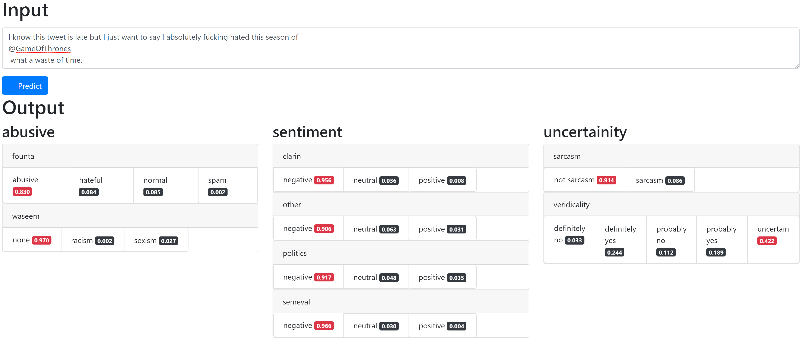
Text classification https://github.com/socialmediaie/SocialMediaIE

Slide 11
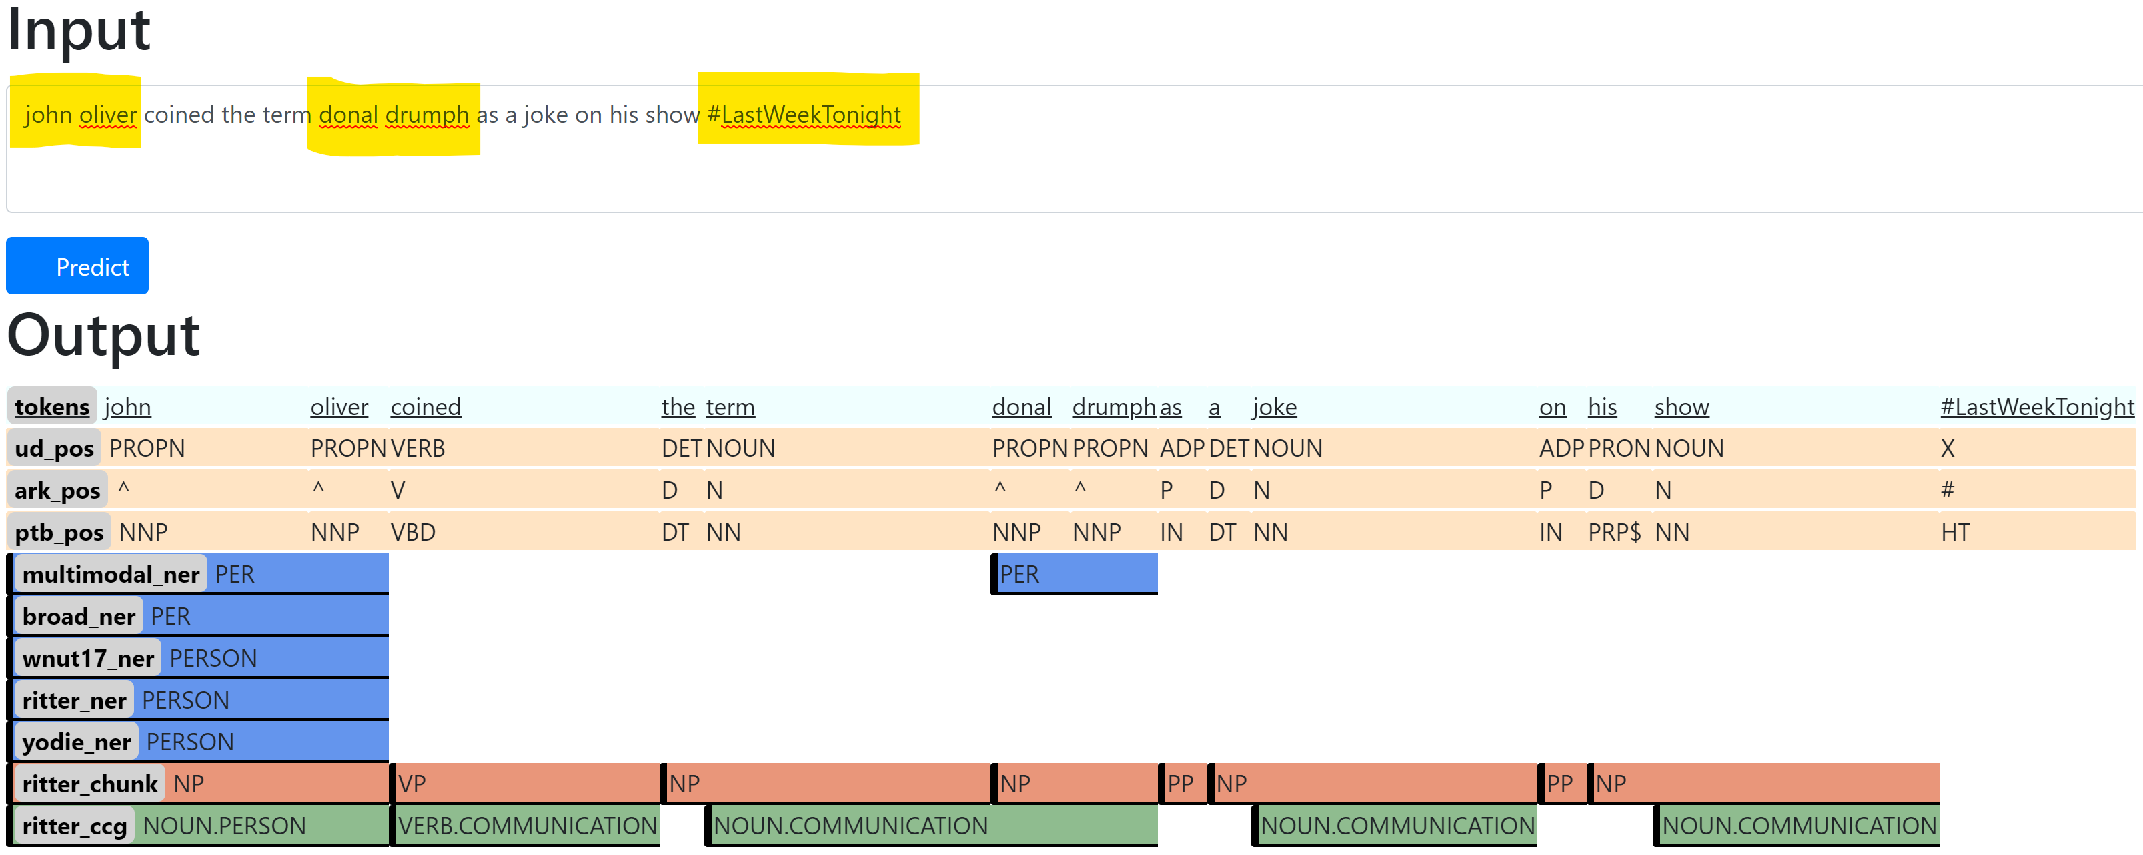
Sequence tagging https://github.com/socialmediaie/SocialMediaIE

Slide 12
Applications of information extraction
Index documents by entities
DocID | Entity | Entity type | WikiURL
1 | Roger Federer | Person | URL1
2 | Facebook | Organization | URL2
3 | Katy Perry | Music Artist | URL3

Slide 13
Entity mention clustering
Washington is a great place.
I just visited Washington.
Washington was a great president.
Washington made some good changes to constitution.

Slide 14
Applications of Information extraction

Slide 15
Applications
Indexing social media corpora in database
Network construction from text corpora,
Visualizing temporal trends in social media corpora using social communication temporal graphs,
Aggregating text-based signals at user level, Improving text classification using user level attributes,
Analyzing social debate using sentiment and political identity signals otherwise,
Detecting and Prioritizing Needs during Crisis Events (e.g., COVID19),
Mining and Analyzing Public Opinion Related to COVID-19, and
Detecting COVID-19 Misinformation in Videos on YouTube

Slide 16
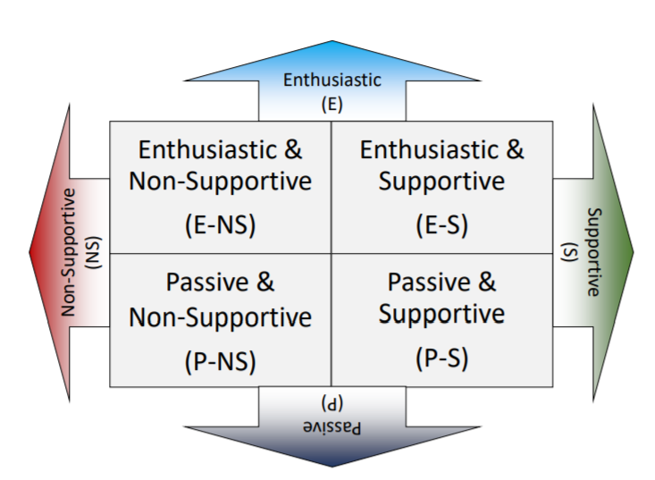
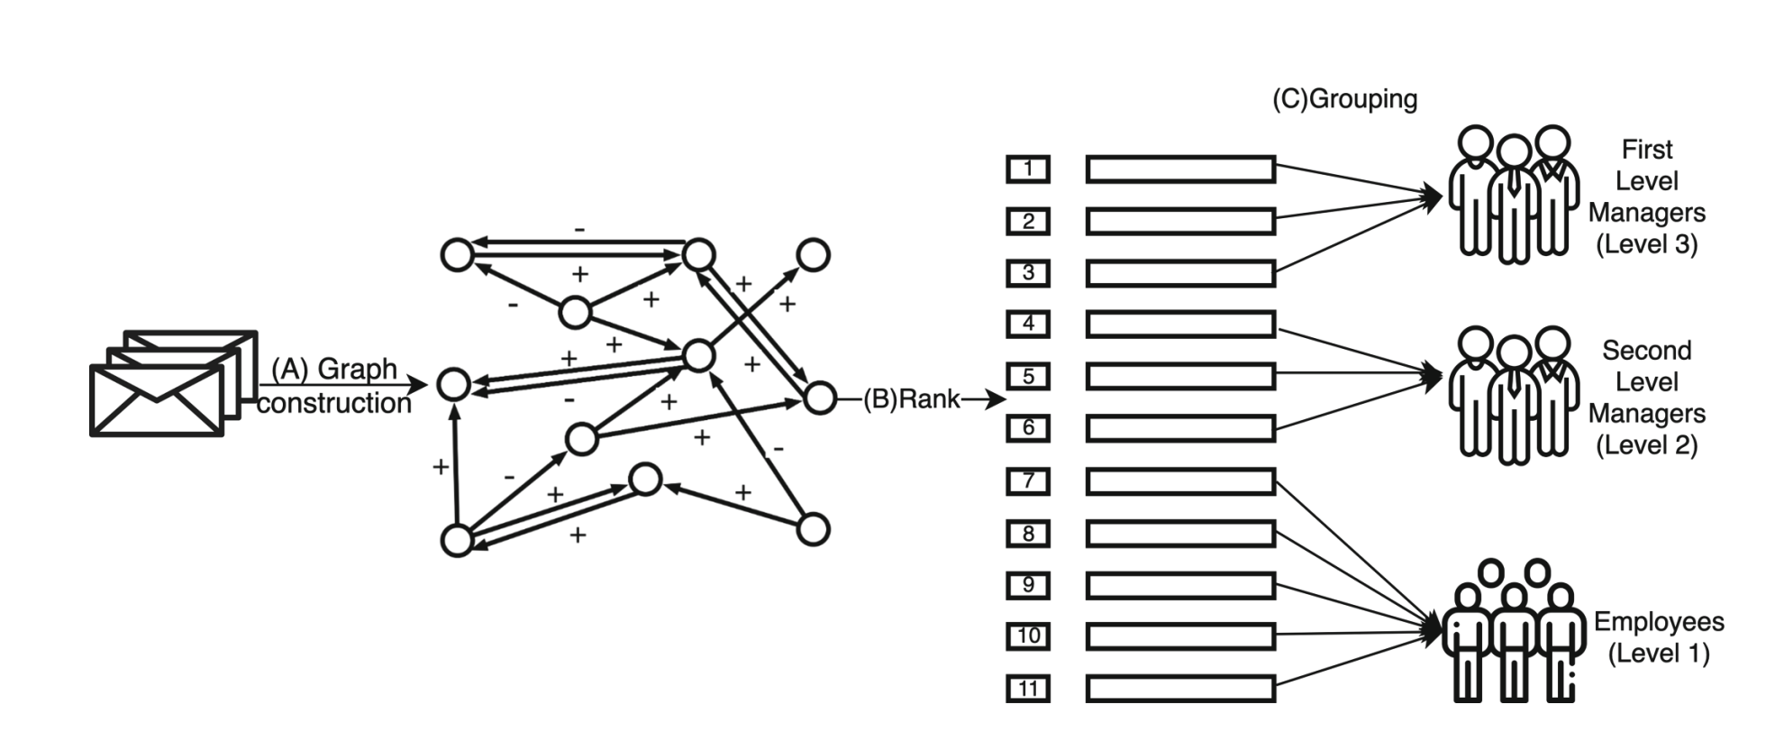
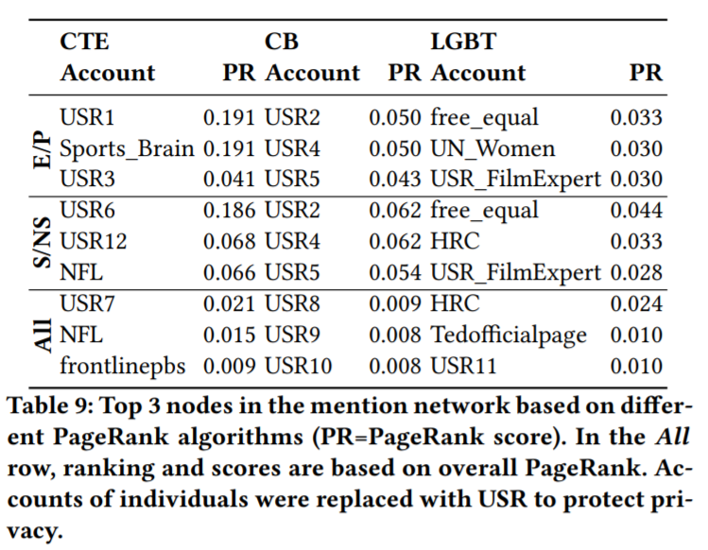
Network construction from text classification labels and identification of influential users
Using signed networks in Email Corpora
Mishra, Shubhanshu, and Jana Diesner. "Capturing signals of enthusiasm and support towards social issues from twitter." Proceedings of the 5th International Workshop on Social Media World Sensors. 2019.
Jiang, Lan, Ly Dinh, Rezvaneh Rezapour, and Jana Diesner. "Which Group Do You Belong To? Sentiment-Based PageRank to Measure Formal and Informal Influence of Nodes in Networks." In International Conference on Complex Networks and Their Applications, pp. 623-636. Springer, Cham, 2020.

Slide 17
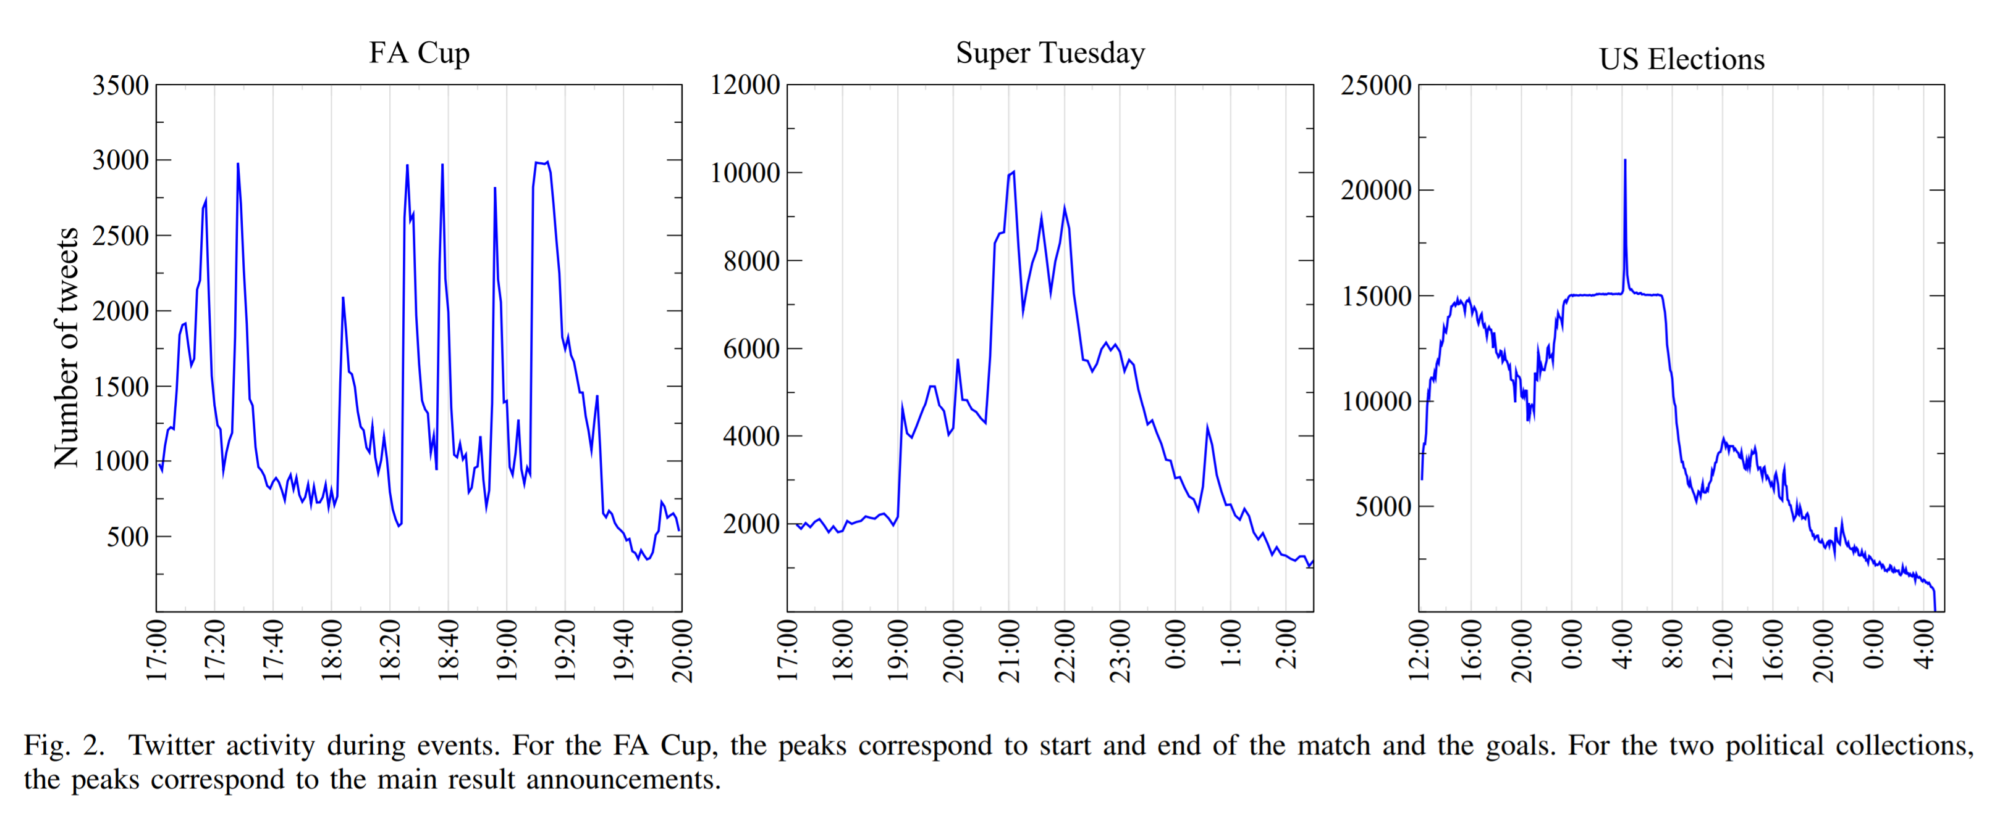
Identifying trending topics and events
Aiello, Luca Maria, Georgios Petkos, Carlos Martin, David Corney, Symeon Papadopoulos, Ryan Skraba, Ayse Göker, Ioannis Kompatsiaris, and Alejandro Jaimes. "Sensing trending topics in Twitter." IEEE Transactions on Multimedia 15, no. 6 (2013): 1268-1282.

Slide 18
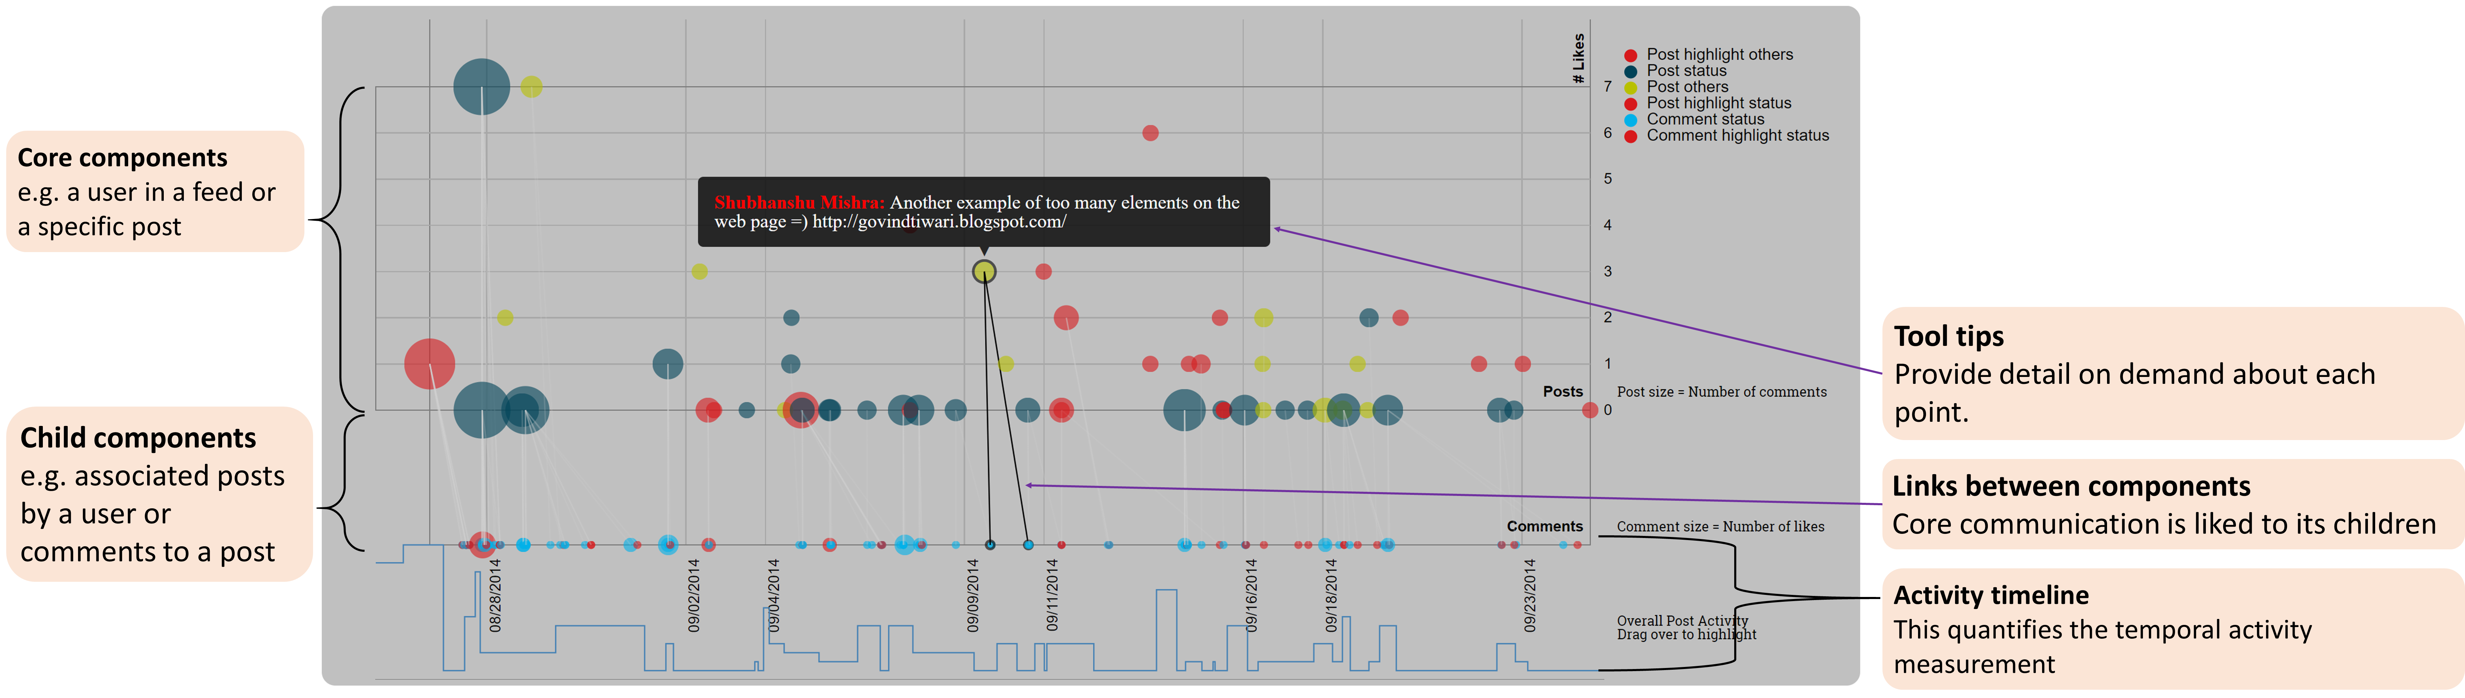
Visualizing temporal trends in data
https://shubhanshu.com/social-comm-temporal-graph/

Slide 19

Lexicon-based Approach
Utilizes a lexicon to describe or extract information from a textual content, e.g., lexicon-based sentiment analysis to analyze polarity of text
What to consider first:
How is the lexicon created
Scope:
Using MPQA lexicon to study hashtags in Tweets
Domain Adaptation
Fine-tuning of the lexicon to represent the data
Evaluation of the results
Error analysis, hand annotation, close-reading,..

Slide 20
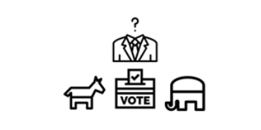
Sentiment Analysis, Presidential Election, and Candidates’ Ranking
Aim:
Test whether incorporating prevalent hashtags from a given dataset into a sentiment lexicon improves sentiment prediction accuracy
Method:
Used hashtag-enhanced lexicon-based sentiment analysis to analyze tweets that mention the US Presidential candidates to find the correlation between the candidates' likeability in tweets with the actual voting outcomes in the New York State Presidential Primary election
Domain adapted the MPQA lexicon:
Extracted and annotated top hashtags and added them to the MPQA lexicon
Rezapour, R., Wang, L., Abdar, O., & Diesner, J. (2017). Identifying the overlap between election result and candidates’ ranking based on hashtag-enhanced, lexicon-based sentiment analysis. In 2017 IEEE 11th International Conference on Semantic Computing (ICSC). (pp. 93-96).

Slide 21
















Using moral foundations to analyze social effects
Motivation:
“A language is not just words. It’s a culture, a tradition, a unification of a community, a whole history that creates what a community is. It’s all embodied in a language.” (Noam Chomsky)
People’s Cognition, Behavior, Attitude, Emotion, and Values
Cultural and Personal Values
(Internal Stimuli)
People’s Everyday Language and Interaction with the World

Slide 22
Using moral foundations analysis in analyzing social effects (contd.)
Method:
Use Moral Foundations Dictionary (MFD) to extract words with moral weights and use them as features in prediction models
Limitations with MFD:
Number of entries is small and might not capture (all) variations of terms indicative of morality in text data.
Entries are not syntactically disambiguated, which can limit the results, e.g., by capturing false positives.
Safe (noun) -> does not signal morality
Safe (adjective) -> represents care-virtue
Enhanced MFD:
Used wordnet to get synonym, antonym and hypernym of the words and extensively pruned the lexicon
Rezapour, R., Shah, S. H., & Diesner, J. (2019). Enhancing the measurement of social effects by capturing morality. In Proceedings of the Tenth Workshop on Computational Approaches to Subjectivity, Sentiment and Social Media Analysis (WASSA). Annual Conference of the North American Chapter of the Association for Computational Linguistics (NAACL).
Rezapour, Rezvaneh; Diesner, Jana (2019): Expanded Morality Lexicon. University of Illinois at Urbana-Champaign. https://doi.org/10.13012/B2IDB-3805242_V1.1
Notes:
Aim: Can the consideration of personal and moral values help us with predicting/studying social effects?

Slide 23
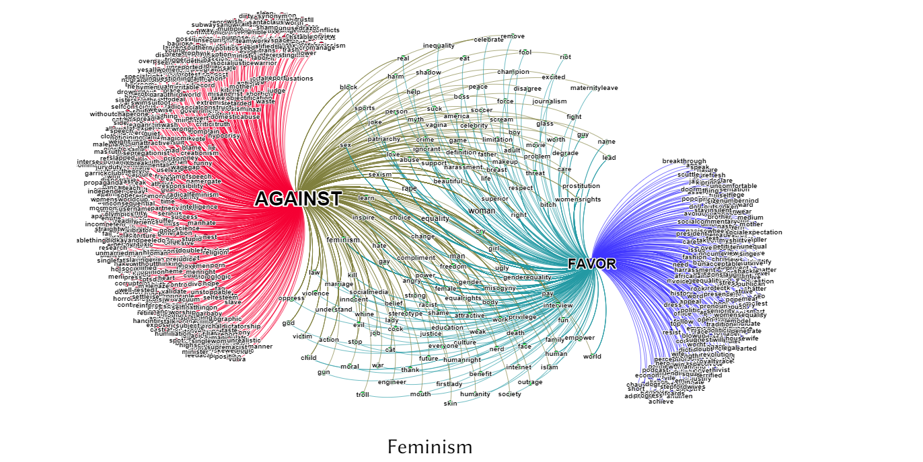
Analyzing Tweets to Examine Cross-Cutting Exposure in Social Media
Rezapour, R., Park, J., Diesner, J. (2020). Detecting Characteristics of Cross-cutting Language Networks on Social Media. In International Sunbelt Social Network Conference, Paris, France.

Slide 24
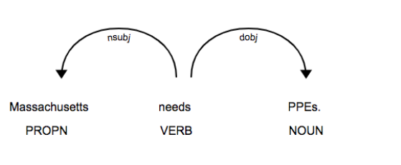
Detecting and Prioritizing Needs during Crisis Events (i.e., COVID19)
Method:
Created a list of needed resources ranked by priority
Extracted phrases and terms closest to the terms “needs” and “supplies”
Extracted sentences that specify who-needs-what resources
Identified sentences where who is the subject and what is the direct object
Selected sentences where the left child of need in the dependency parse tree is a nominal subject (nsubj), and the right child is a direct object (dobj)
Sarol, M. J., Dinh, L., Rezapour, R., Chin, C. L., Yang, P., & Diesner, J. (2020, November). An Empirical Methodology for Detecting and Prioritizing Needs during Crisis Events. In Proceedings of the 2020 Conference on Empirical Methods in Natural Language Processing: Findings (pp. 4102-4107).

Slide 25
More on COVID 19 Crisis
Hate speech detection (Hardage et al. 2020)
Misinformation related to COVID 19 (Hossain et al. 2020)
Symptom detection using social media data (Santosh et al. 2020)
Impact of COVID 19 on language diversity (Dunn et al. 2020)
Quantifying the effects of COVID 19 on mental health (Biester at al. 2020)

Slide 26
Collecting and distributing social media data

Slide 27

Use of Social Media Data for Research
Publicly available online data provides a unique source of rich input for analyzing and studying people, their behavior, and feelings
Availability of different tools from domains such as NLP and ML made it easier for everyone to perform various types of data analysis
Things to consider before using any data:
How the data is it collected
Is the data reusable for your research
Is the data representative enough
Does the data or method answer your research question
How generalizable is the findings?

Slide 28
Publicly available social media data
Many researchers make annotated social media data publicly available for academic research.
Good place for benchmarking or evaluating your models.
Many datasets available for text classification.
Few for information extraction via sequence tagging (but still enough)
Varied annotation practices and data scope:
We have curated a large collection of social media corpuses from academic research at: https://socialmediaie.github.io/MetaCorpus/

Slide 29
Tagging data
Named entity recognition
https://shubhanshu.com/phd_thesis
Part of speech tagging
Super sense tagging
Chunking

Slide 30
Classification data
https://shubhanshu.com/phd_thesis
Abusive content identification
Sentiment classification
Uncertainty indicator classification

Slide 31
Collecting new social media data
Twarc is a good tool to collect Twitter data: https://twarc-project.readthedocs.io/en/latest/
It requires that you have a Twitter Developer API key - https://developer.twitter.com/en/apps
It also allows you to also hydrate tweet IDs to tweet json using the API
Often a file with one tweet ID per line can be hydrated as: twarc hydrate ids.txt > data.jsonl twarc search blacklivesmatter > tweets.jsonl twarc followers jack > users.jsonl twarc users ids.txt > users.jsonl

Slide 32
Methods for Extracting Information from Social Media Data
Machine learning approaches
Rule or Lexicon-based approaches
Network analysis

Slide 33
GUI tool for using IE to extract networks from text data
ConText tool: http://context.ischool.illinois.edu/
Bread and butter techniques for text analysis and extracting relational data from text data
Convert text into network data
Notes:
Making some IE tasks practically useful for newcomers

Slide 34
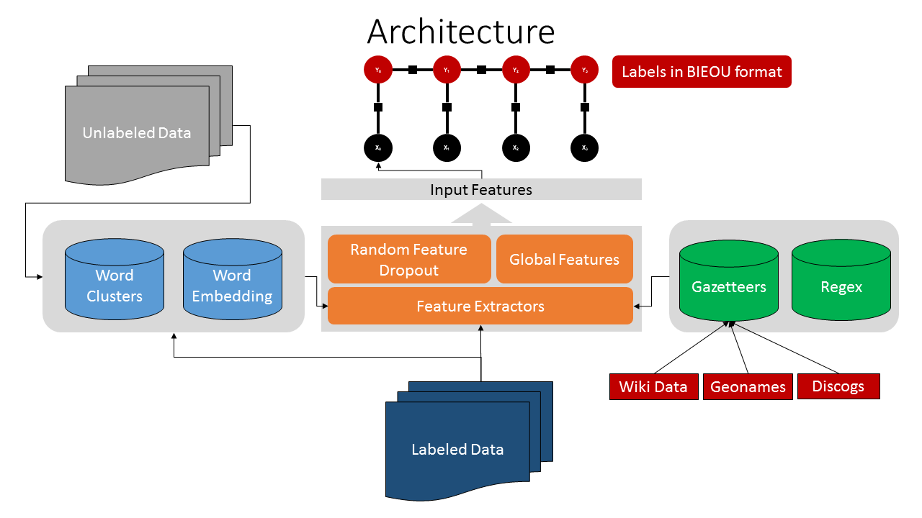
Rule based Twitter NER Mishra & Diesner (2016). https://github.com/napsternxg/TwitterNER
Mishra, Shubhanshu, & Diesner, Jana (2016). Semi-supervised Named Entity Recognition in noisy-text. In Proceedings of the 2nd Workshop on Noisy User-generated Text (WNUT) (pp. 203–212). Osaka, Japan: The COLING 2016 Organizing Committee. Retrieved from https://aclweb.org/anthology/papers/W/W16/W16-3927/

Slide 35
Evaluating Twitter NER (F1-score) Mishra & Diesner (2016).
Rank | 1 | 2 | 3 | 4 | 5 | 6 | 7 | 8 | 9 | 10 | TD | TDT_{E}
10-types | 52.4 | 46.2 | 44.8 | 40.1 | 39.0 | 37.2 | 37.0 | 36.2 | 29.8 | 19.3 | 46.4 | 47.3
No-types | 65.9 | 63.2 | 60.2 | 59.1 | 55.2 | 51.4 | 47.8 | 46.7 | 44.3 | 40.7 | 57.3 | 59.0
company | 57.2 | 46.9 | 43.8 | 31.3 | 38.9 | 34.5 | 25.8 | 42.6 | 24.3 | 10.2 | 42.1 | 46.2
facility | 42.4 | 31.6 | 36.1 | 36.5 | 20.3 | 30.4 | 37.0 | 40.5 | 26.3 | 26.1 | 37.5 | 34.8
geo-loc | 72.6 | 68.4 | 63.3 | 61.1 | 61.1 | 57.0 | 64.7 | 60.9 | 47.4 | 37.0 | 70.1 | 71.0
movie | 10.9 | 5.1 | 4.6 | 15.8 | 2.9 | 0.0 | 4.0 | 5.0 | 0.0 | 5.4 | 0.0 | 0.0
musicartist | 9.5 | 8.5 | 7.0 | 17.4 | 5.7 | 37.2 | 1.8 | 0.0 | 2.8 | 0.0 | 7.6 | 5.8
other | 31.7 | 27.1 | 29.2 | 26.3 | 21.1 | 22.5 | 16.2 | 13.0 | 22.6 | 8.4 | 31.7 | 32.4
person | 59.0 | 51.8 | 52.8 | 48.8 | 52.0 | 42.6 | 40.5 | 52.3 | 34.1 | 20.6 | 51.3 | 52.2
product | 20.1 | 11.5 | 18.3 | 3.8 | 10.0 | 7.3 | 5.7 | 15.4 | 6.3 | 0.8 | 10.0 | 9.3
sportsteam | 52.4 | 34.2 | 38.5 | 18.5 | 34.6 | 15.9 | 9.1 | 19.7 | 11.0 | 0.0 | 31.3 | 32.0
tvshow | 5.9 | 0.0 | 4.7 | 5.4 | 7.3 | 9.8 | 4.8 | 0.0 | 5.1 | 0.0 | 5.7 | 5.7
Rank | 1 | 2 | 3 | 4 | 5 | 6 | 7 | 8 | 9 | 10 | ~2 | ~2

Slide 36
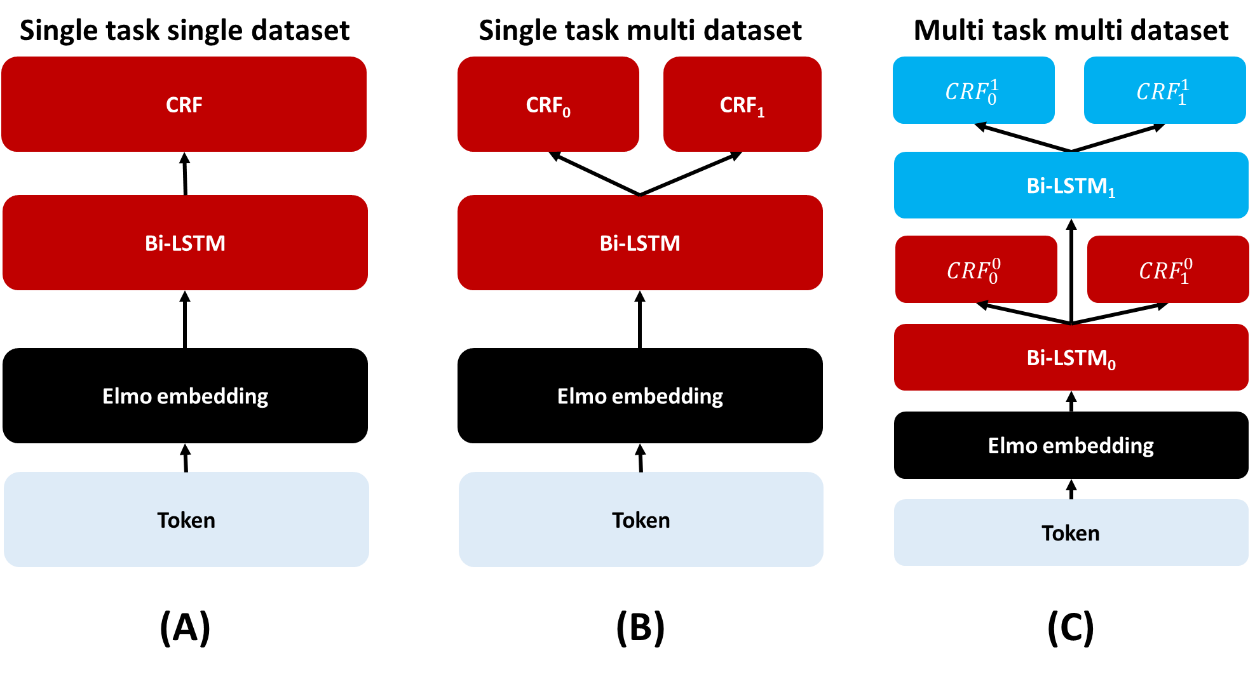
Multi-task-multi-dataset learning Mishra 2019, HT’ 19
S - Single
MD – Multi-dataset
MTS – Multi task Shared
MTL – Multi task Stacked (Layered)
Shubhanshu Mishra. 2019. Multi-dataset-multi-task Neural Sequence Tagging for Information Extraction from Tweets. In Proceedings of the 30th ACM Conference on Hypertext and Social Media (HT '19). ACM, New York, NY, USA, 283-284. DOI: https://doi.org/10.1145/3342220.3344929

Slide 37
Evaluating MTL models Mishra 2019, HT’ 19
Part of speech tagging (overall accuracy)
Named entity recognition (micro f1)
Super sense tagging (micro f1)
Shubhanshu Mishra. 2019. Multi-dataset-multi-task Neural Sequence Tagging for Information Extraction from Tweets. In Proceedings of the 30th ACM Conference on Hypertext and Social Media (HT '19). ACM, New York, NY, USA, 283-284. DOI: https://doi.org/10.1145/3342220.3344929
Chunking (micro f1)

Slide 38
Training Mishra 2019, HT’ 19
Sample mini-batches from a task/data
Compute loss for the mini-batch
Individual loss is the log loss for conditional random field
Update the model except the Elmo module
During an epoch go through all tasks and datasets
Train for a max number of epochs
Use early stopping to stop training
Models trained on single datasets have prefix S
Models trained on all datasets of same task have prefix MD
Models trained on all datasets have prefix MTS for multitask models with shared module, and MTL for stacked modules
Models with LR=1e-3 and no L2 regularization have suffix "*"
Models trained without NEEL2016 have suffix "#"

Slide 39
Label embeddings (POS)
MDMT model learns similarity between labels without this knowledge being encoded in the model
This leads to consistent relationship between similar labels across datasets
Notes:
O WP PRP different variants of PRONOUN
Mapping for PTB to UD - https://universaldependencies.org/tagset-conversion/en-penn-uposf.html
Mapping for ARK to UD - https://dkpro.github.io/dkpro-core/releases/1.9.0/docs/tagset-reference.html#tagset-en-arktweet-pos

Slide 40
Label embeddings (NER)
MDMT model learns similarity between labels without this knowledge being encoded in the model
This leads to consistent relationship between similar labels across datasets

Slide 41
Label embeddings (chunking)
MDMT model learns similarity between labels without this knowledge being encoded in the model
This leads to consistent relationship between similar labels across datasets

Slide 42
Label embeddings (super-sense tagging)
MDMT model learns similarity between labels without this knowledge being encoded in the model
This leads to consistent relationship between similar labels across datasets

Slide 43
Label embeddings (super-sense tagging)
MDMT model learns similarity between labels without this knowledge being encoded in the model
This leads to consistent relationship between similar labels across datasets

Slide 44
Web based UI https://github.com/socialmediaie/SocialMediaIE

Slide 45
Multi-task-multi-dataset learning - classification
Abusive content identification
Sentiment classification
Uncertainty indicator classification
https://github.com/socialmediaie/SocialMediaIE

Slide 46
Sentiment classification results https://github.com/socialmediaie/SocialMediaIE

Slide 47
https://github.com/socialmediaie/SocialMediaIE
Abusive content identification
Uncertainty indicators

Slide 48
Label embeddings
MDMT model learns similarity between labels without this knowledge being encoded in the model
This leads to consistent relationship between similar labels across datasets
https://github.com/socialmediaie/SocialMediaIE

Slide 49
Web based UI https://github.com/socialmediaie/SocialMediaIE

Slide 50
Incremental learning of text classifiers with human-in-the-loop
Given a large unlabeled corpus, can we label it efficiently using fewer human annotations?
Can existing models be updated efficiently to work with new data?
Proposal:
Use active learning for data labeling
Use incremental learning algorithms for model updates
Highly application to social media data:
Streaming data
Model should adapt to new data
Mishra, Shubhanshu, Jana Diesner, Jason Byrne, and Elizabeth Surbeck. 2015. “Sentiment Analysis with Incremental Human-in-the-Loop Learning and Lexical Resource Customization.” In Proceedings of the 26th ACM Conference on Hypertext & Social Media - HT ’15, 323–25. New York, New York, USA: ACM Press. https://doi.org/10.1145/2700171.2791022.

Slide 51
Active Learning
Given a model and unlabeled data
Select samples from the unlabeled data to be annotated, based on selection criterion
Update model with collected labeled examples
Repeat steps 2 to 3 till desired accuracy is reached or data exhausted
Mishra et al. (2015)

Slide 52
Mishra et al. (2015)

Slide 53
Each round query 100 samples
Classifier is logistic regression with unigram and lexicon features
Max rounds is 100 (except Clarin)
Data ordered alphabetically and X and Y axes are not shared.
https://github.com/socialmediaie/SocialMediaIE

Slide 54
Evaluate only on the data not used for training
Top strategy queries efficiently and can help in labeling full data more quickly.
Data ordered alphabetically and X and Y axes are not shared.
https://github.com/socialmediaie/SocialMediaIE

Slide 55
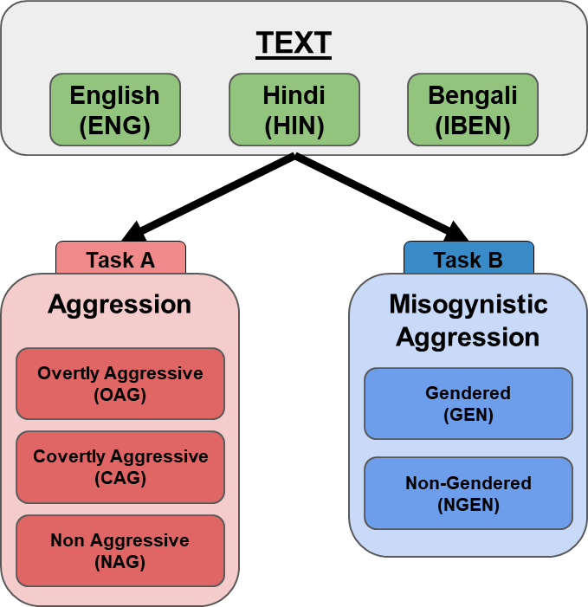
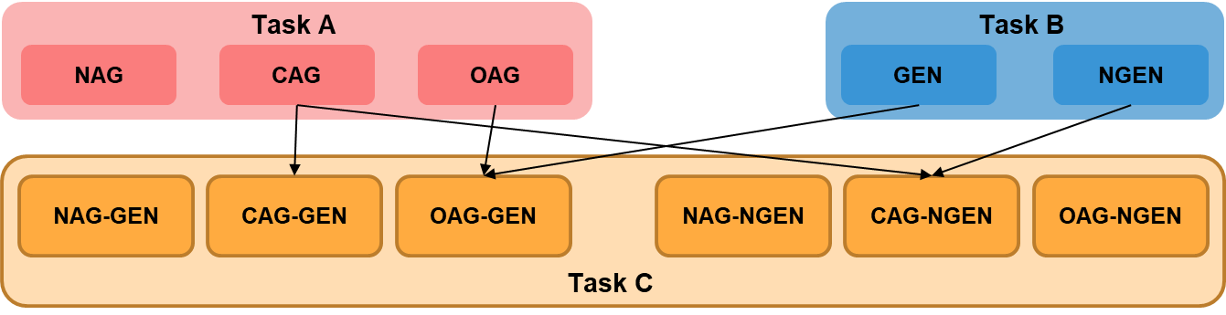
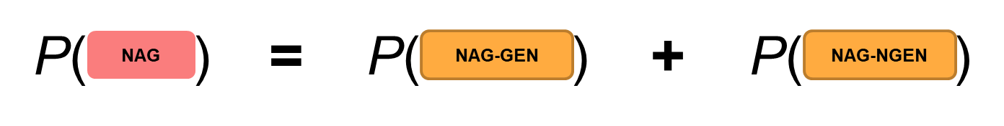
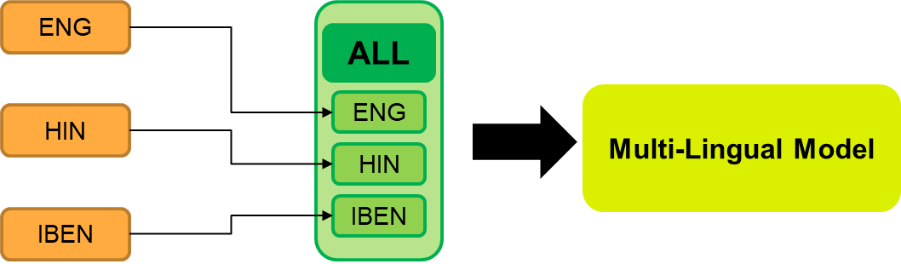
Multilingual Joint Fine-tuning of Transformer models for identifying Trolling, Aggression and Cyberbullying at TRAC 2020
https://github.com/socialmediaie/TRAC2020
2nd in 1/6 sub-tasks: ENG A
3rd in 3/6 sub-tasks: HIN A, B, and IBEN B
4th in 1/6 sub-tasks: ENG B
Computationally faster and cheaper inference cost.

Slide 56
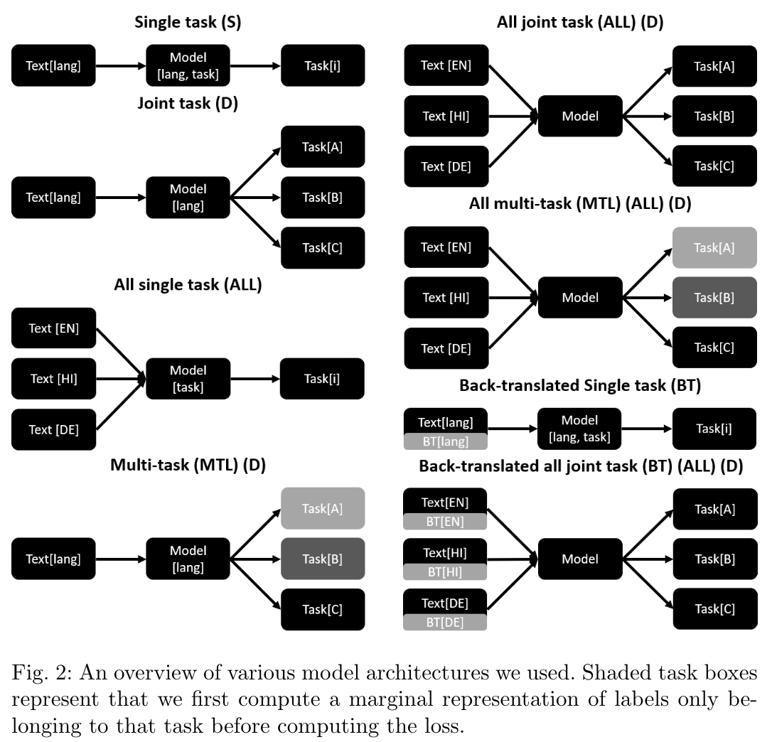
Multilingual learning for hate speech detection
Mishra, S., Prasad, S. & Mishra, S. Exploring Multi-Task Multi-Lingual Learning of Transformer Models for Hate Speech and Offensive Speech Identification in Social Media. SN COMPUT. SCI. 2, 72 (2021). https://doi.org/10.1007/s42979-021-00455-5
Code: https://github.com/socialmediaie/MTML_HateSpeech

Slide 57
Improving sentiment classification using user and tweet metadata
Sentiment is usually identified as positive, negative, and neutral.
Twitter Sentiment Corpora
Are our corpora biased to certain meta-data attributes?
Can those biases propagate into systems trained on these corpora?
How correlated are these meta-data features with the annotated sentiment?
Do these correlations hold outside of the annotated data for the same users?
Can sentiment classifiers exploit this bias to do well on these datasets?
Tweet:
Text
Sentiment
# of URLs, Hashtags, Mentions
Created at
Retweets
Replies
Is reply or quote?
User:
Created at
# Followers, Friends, Statuses
Is verified or has profile URL?
What we use
What we discard
Mishra, S., & Diesner, J. (2018, July 3). Detecting the Correlation between Sentiment and User-level as well as Text-Level Meta-data from Benchmark Corpora. Proceedings of the 29th on Hypertext and Social Media. HT ’18: 29th ACM Conference on Hypertext and Social Media. https://doi.org/10.1145/3209542.3209562

Slide 58
Types of metadata and what they quantify
Quantification | User metadata
Activity level | # Statuses
Social Interest of the user | # Friends
Social status | # Followers
Account age | # days since account creation to posted tweet
Profile authenticity | Presence of URL on the profile or if the profile is verified
Quantification | Tweet metadata
Topical variety | # hashtags
Reference to sources | # URLs
Reference to network | # user mentions
Part of conversation | Is reply
Reference to conversation | Is quote

Slide 59
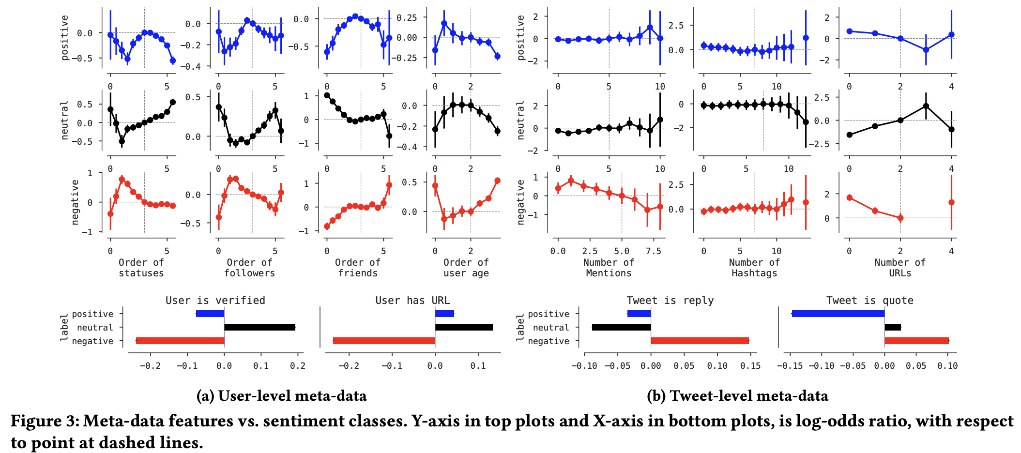
User metadata v/s Sentiment

Slide 60
Using metadata features can improve sentiment classification
Dataset | Model | Acc. | P | R | F1 | KLD
Airline | meta | 63.9 | 61.1 | 36.8 | 32.8 | 0.663
 | text | 80.0 | 78.3 | 69.0 | 72.4 | 0.026
 | joint | 80.3 | 76.6 | 72.0 | 74.0 | 0.005
Clarin | meta | 45.7 | 42.1 | 40.9 | 37.8 | 0.238
 | text | 64.1 | 64.5 | 62.2 | 62.9 | 0.012
 | joint | 64.1 | 64.0 | 63.0 | 63.4 | 0.000
GOP | meta | 59.9 | 54.3 | 37.5 | 33.6 | 0.776
 | text | 66.4 | 63.7 | 51.4 | 53.6 | 0.111
 | joint | 65.6 | 59.9 | 56.5 | 57.8 | 0.006
Healthcare | meta | 56.7 | 36.8 | 39.4 | 35.1 | 0.717
 | text | 64.2 | 71.3 | 49.5 | 51.0 | 0.233
 | joint | 65.6 | 61.6 | 58.3 | 59.5 | 0.007
Obama | meta | 39.3 | 37.0 | 35.1 | 32.0 | 0.282
 | text | 61.5 | 64.8 | 59.7 | 60.9 | 0.030
 | joint | 62.3 | 63.2 | 61.6 | 62.2 | 0.002
SemEval | meta | 47.0 | 31.0 | 36.2 | 33.0 | 0.845
 | text | 65.5 | 64.1 | 58.0 | 59.5 | 0.032
 | joint | 65.6 | 62.7 | 60.5 | 61.4 | 0.001
Boost in F1 is mostly due to better recall. Precision is lower.
MESC might be helping with tweets with high OOV rates, where text classifiers don’t do well.

Slide 61
Hands on session using SocialMediaIE
Links to install instructions and google colaboratory notebook at:
https://socialmediaie.github.io/tutorials/WWW2021

Slide 62
List of social media IE tools
SocialMediaIE - https://github.com/socialmediaie/SocialMediaIE
TwitterNER - https://github.com/socialmediaie/TwitterNER (more lightweight NER focused on English tweets)
Social Communication Temporal Graph - https://github.com/napsternxg/social-comm-temporal-graph/ (visualizing temporal networks)
ConText - https://github.com/uiuc-ischool-scanr/ConText (generate networks from text data)
SAIL - https://github.com/uiuc-ischool-scanr/SAIL (active learning for text classification, python version coming soon at https://github.com/socialmediaie/)

Slide 63
Using SocialMediaIE for IE from text
Notebook link: https://colab.research.google.com/drive/1ptfxPMGBsvsSRzoas7_qD2D_m1WrbbNp?usp=sharing
Use one multi-task model to extract POS, named entities, chunks, and super-sense tags from text efficiently
Use one multi-task model to label sentiment, abusive content, and uncertainty (sarcasm and veridicality) from text efficiently
Copy the model output JSON to our UI interface https://codepen.io/napsternxg/full/YzwRqEb to see visual representation of the labels
Try on your own text data
Try to run SocialMediaIE on your local machine

Slide 64
Other models for multi-task learning
Hierarchical labels or multi-label settings
Mishra, S., Prasad, S., & Mishra, S. (2020). Multilingual Joint Fine-tuning of Transformer models for identifying Trolling, Aggression and Cyberbullying at TRAC 2020. In Proceedings of the Second Workshop on Trolling, Aggression and Cyberbullying (pp. 120–125). Marseille, France: European Language Resources Association (ELRA). Retrieved from https://www.aclweb.org/anthology/2020.trac-1.19. Code: https://github.com/socialmediaie/TRAC2020
Mishra, S., & Mishra, S. (2019). 3Idiots at HASOC 2019: Fine-tuning Transformer Neural Networks for Hate Speech Identification in Indo-European Languages. In FIRE (Working Notes) (pp. 208-213). Retrieved from http://ceur-ws.org/Vol-2517/T3-4.pdf. Code: https://github.com/socialmediaie/HASOC2019

Slide 65
Visualize temporal network of social media data in your browser
Social Communication Temporal Graph: https://shubhanshu.com/social-comm-temporal-graph/
Recent tweet comparison – Compare user-tweet network on tweets about 2 search queries
Recent Tweet Sentiments – Compare user and tweet level sentiment on tweets about a single search query
Wikipedia Revisions – Compare Wikipedia edit activity across 2 pages and identify common users

Slide 66
Thank you
Questions
Tweet to us at:
Shubhanshu Mishra - @TheShubhanshu
Rezvaneh (Shadi) Rezapour - @shadi_rezapour
Jana Diesner - @janadiesner @DiesnerLab
All material presented here can be found at: https://socialmediaie.github.io/tutorials/WWW2021/
If you have questions or feature requests about any of the tools open an issue on github e.g. for SocialMediaIE at: https://github.com/socialmediaie/SocialMediaIE/issues

Slide 67
References
Diesner, J. (2015) Small decisions with big impact on data analytics. Big Data & Society, special issue on Assumptions of Sociality, 2(2). doi: 10.1177/2053951715617185
Diesner, J. (2013). From Texts to Networks: Detecting and managing the impact of methodological choices for extracting network data from text data. Kuenstliche Intelligenz Journal (Artificial Intelligence), 27(1), 75-78.
Mishra, Shubhanshu (2019): Trained models for multi-task multi-dataset learning for text classification as well as sequence tagging in tweets. University of Illinois at Urbana-Champaign. https://doi.org/10.13012/B2IDB-1094364_V1
Mishra, Shubhanshu (2019): Trained models for multi-task multi-dataset learning for text classification in tweets. University of Illinois at Urbana-Champaign. https://doi.org/10.13012/B2IDB-1917934_V1
Mishra, Shubhanshu (2019): Trained models for multi-task multi-dataset learning for sequence prediction in tweets. University of Illinois at Urbana-Champaign. https://doi.org/10.13012/B2IDB-0934773_V1
Shubhanshu Mishra. 2019. Multi-dataset-multi-task Neural Sequence Tagging for Information Extraction from Tweets. In Proceedings of the 30th ACM Conference on Hypertext and Social Media (HT '19). ACM, New York, NY, USA, 283-284. DOI: https://doi.org/10.1145/3342220.3344929

Slide 68
References
Mishra, Shubhanshu, & Diesner, Jana (2016). Semi-supervised Named Entity Recognition in noisy-text. In Proceedings of the 2nd Workshop on Noisy User-generated Text (WNUT) (pp. 203–212). Osaka, Japan: The COLING 2016 Organizing Committee. Retrieved from https://aclweb.org/anthology/papers/W/W16/W16-3927/
Mishra, Shubhanshu, Diesner, Jana, Byrne, Jason, & Surbeck, Elizabeth (2015). Sentiment Analysis with Incremental Human-in-the-Loop Learning and Lexical Resource Customization. In Proceedings of the 26th ACM Conference on Hypertext & Social Media - HT ’15 (pp. 323–325). New York, New York, USA: ACM Press. https://doi.org/10.1145/2700171.2791022
Rezapour, Rezvaneh., Wang, Lufan., Abdar, Omid., & Diesner, Jana. (2017). Identifying the Overlap Between Election Result and Candidates’ Ranking based on Hashtag-enhanced, Lexicon-based Sentiment Analysis. Proceedings of IEEE 11th International Conference on Semantic Computing (ICSC), (pp. 93-96), San Diego, CA. doi: 10.1109/ICSC.2017.92
Rezapour, Rezvaneh., Shah, Saumil., & Diesner, Jana. (2019) Enhancing the Measurement of Social Effects by Capturing Morality. Proceedings of the 10th Workshop on Computational Approaches to Subjectivity, Sentiment and Social Media Analysis (WASSA). Annual Conference of the North American Chapter of the Association for Computational Linguistics (NAACL), Minneapolis, MN. [pdf]
Sarol, M. Janina., Dinh, Ly., Rezapour, Rezvaneh., Chin, Chieh-Li., Yang, P.ingjing, & Diesner, Jana. (2020, November). An Empirical Methodology for Detecting and Prioritizing Needs during Crisis Events. In Proceedings of the 2020 Conference on Empirical Methods in Natural Language Processing: Findings (pp. 4102-4107). [pdf]

Slide 69
References
Santosh, R., Schwartz, H. A., Eichstaedt, J. C., Ungar, L. H., & Guntuku, S. C. (2020). Detecting Emerging Symptoms of COVID-19 using Context-based Twitter Embeddings. In Proceedings of the 1st Workshop on NLP for COVID-19 (Part 2) at EMNLP 2020. [pdf]
Dunn, J., Coupe, T., & Adams, B. (2021). Measuring linguistic diversity during covid-19. In Proceedings of the Fourth Workshop on Natural Language Processing and Computational Social Science, pages 1–10 Online. [pdf]
Hossain, T., Logan IV, R. L., Ugarte, A., Matsubara, Y., Young, S., & Singh, S. (2020, December). COVIDLies: Detecting COVID-19 Misinformation on Social Media. In Proceedings of the 1st Workshop on NLP for COVID-19 (Part 2) at EMNLP 2020. [pdf]
Hardage, D., & Najafirad, P. (2020). Hate and Toxic Speech Detection in the Context of Covid-19 Pandemic using XAI: Ongoing Applied Research. [pdf]
Biester, L., Matton, K., Rajendran, J., Provost, E. M., & Mihalcea, R. Quantifying the Effects of COVID-19 on Mental Health Support Forums. [pdf]

Slide 70
Covid 19
Suggested papers:
Mining and Analyzing Public Opinion Related to COVID-19, and
Detecting COVID-19 Misinformation in Videos on YouTube
Temporal Mental Health Dynamics on Social Media
COVIDLIES: Detecting COVID-19 Misinformation on Social Media
Annotating the Pandemic: Named Entity Recognition and Normalisation in COVID-19 Literature
Detecting Emerging Symptoms of COVID-19 using Context-based Twitter Embeddings
Hate and Toxic Speech Detection in the Context of Covid-19 Pandemic using XAI: Ongoing Applied Research
Measuring Linguistic Diversity During COVID-19

